Slide 1
Chapter 6
Valuing Bonds

Slide 2
Chapter Outline
6.1 Bond Cash Flows, Prices, and Yields
6.2 Dynamic Behavior of Bond Prices
6.3 The Yield Curve and Bond Arbitrage
6.4 Corporate Bonds
6.5 Sovereign Bonds

Slide 3
6.1 Bond Cash Flows, Prices, and Yields
Bond Terminology
Bond Certificate
States the terms of the bond
Maturity Date
Final repayment date
Term
The time remaining until the repayment date
Coupon
Promised interest payments

Slide 4
6.1 Bond Cash Flows, Prices, and Yields (cont'd)
Bond Terminology
Face Value
Notional amount used to compute the interest payments
Coupon Rate
Determines the amount of each coupon payment, expressed as an APR
Coupon Payment

Slide 5
Zero-Coupon Bonds
Zero-Coupon Bond
Does not make coupon payments
Always sells at a discount (a price lower than face value), so they are also called pure discount bonds
Treasury Bills are U.S. government zero-coupon bonds with a maturity of up to one year.

Slide 6
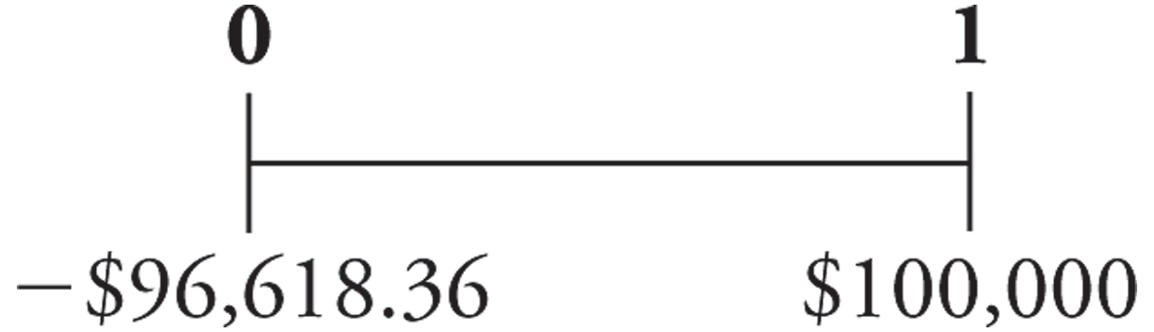
Zero-Coupon Bonds (cont'd)
Suppose that a one-year, risk-free, zero-coupon bond with a $100,000 face value has an initial price of $96,618.36. The cash flows would be
Although the bond pays no “interest,” your compensation is the difference between the initial price and the face value.

Slide 7
Zero-Coupon Bonds (cont'd)
Yield to Maturity
The discount rate that sets the present value of the promised bond payments equal to the current market price of the bond.
Price of a Zero-Coupon bond

Slide 8
Zero-Coupon Bonds (cont'd)
Yield to Maturity
For the one-year zero coupon bond:
Thus, the YTM is 3.5%.

Slide 9
Zero-Coupon Bonds (cont'd)
Yield to Maturity
Yield to Maturity of an n-Year Zero-Coupon Bond

Slide 10
Zero-Coupon Bonds (cont'd)
Risk-Free Interest Rates
A default-free zero-coupon bond that matures on date n provides a risk-free return over the same period. Thus, the Law of One Price guarantees that the risk-free interest rate equals the yield to maturity on such a bond.
Risk-Free Interest Rate with Maturity n

Slide 11
Zero-Coupon Bonds (cont'd)
Risk-Free Interest Rates
Spot Interest Rate
Another term for a default-free, zero-coupon yield
Zero-Coupon Yield Curve
A plot of the yield of risk-free zero-coupon bonds as a function of the bond’s maturity date

Slide 12
Coupon Bonds
Coupon Bonds
Pay face value at maturity
Pay regular coupon interest payments
Treasury Notes
U.S. Treasury coupon security with original maturities of 1–10 years
Treasury Bonds
U.S. Treasury coupon security with original maturities over 10 years

Slide 13
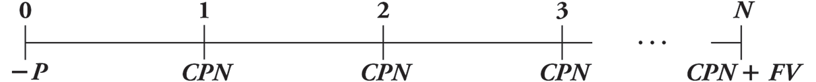
Coupon Bonds (cont'd)
Yield to Maturity
The YTM is the single discount rate that equates the present value of the bond’s remaining cash flows to its current price.
Yield to Maturity of a Coupon Bond

Slide 14
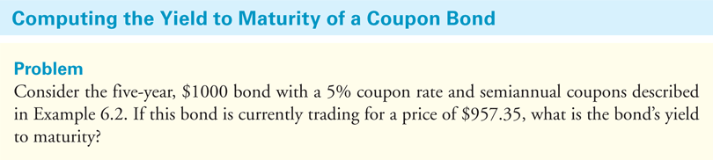
Textbook Example 6.3

Slide 15
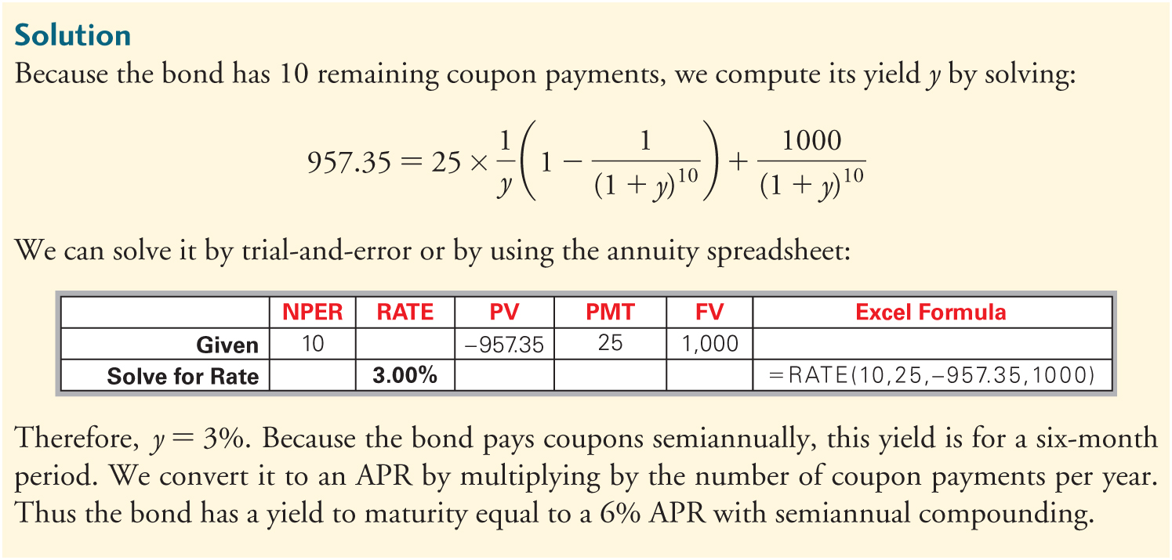
Textbook Example 6.3 (cont'd)

Slide 16
Financial Calculator Solution
Since the bond pays interest semi-annually, the calculator should be set to 2 periods per year.

Slide 17
Alternative Example 6.3
Problem
Consider the following semi-annual bond:
$1000 par value
7 years until maturity
9% coupon rate
Price is $1,080.55
What is the bond’s yield to maturity?
Notes:
17

Slide 18
Alternative Example 6.3
Solution
N = 7 years × 2 = 14
PMT = (9% × $1000) ÷ 2 = $45
Notes:
18

Slide 19
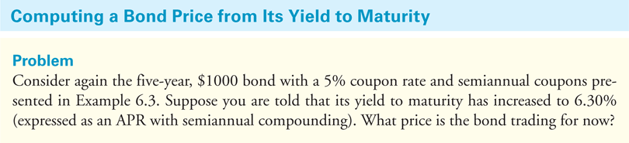
Textbook Example 6.4

Slide 20
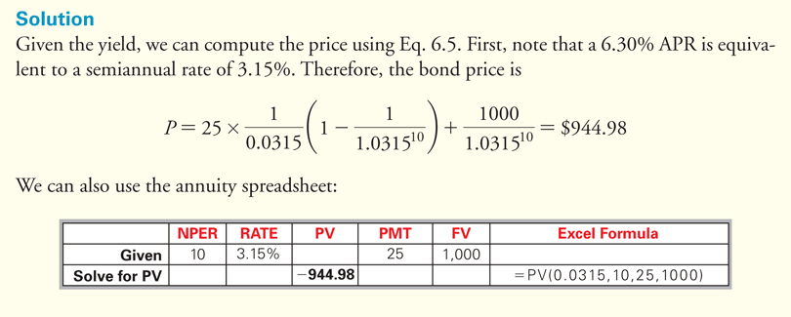
Textbook Example 6.4 (cont'd)

Slide 21
Financial Calculator Solution
Since the bond pays interest semi-annually, the calculator should be set to 2 periods per year.

Slide 22
Alternative Example 6.4
Problem
Consider the bond in the previous example.
Suppose its yield to maturity has increased to 10%
What is the bond’s new price?
Notes:
22

Slide 23
Alternative Example 6.4
Solution
N = 7 years × 2 = 14
PMT = (9% × $1000) ÷ 2 = $45
Notes:
23

Slide 24
6.2 Dynamic Behavior of Bond Prices
Discount
A bond is selling at a discount if the price is less than the face value.
Par
A bond is selling at par if the price is equal to the face value.
Premium
A bond is selling at a premium if the price is greater than the face value.

Slide 25
Discounts and Premiums
If a coupon bond trades at a discount, an investor will earn a return both from receiving the coupons and from receiving a face value that exceeds the price paid for the bond.
If a bond trades at a discount, its yield to maturity will exceed its coupon rate.

Slide 26
Discounts and Premiums (cont'd)
If a coupon bond trades at a premium, it will earn a return from receiving the coupons, but this return will be diminished by receiving a face value less than the price paid for the bond.
Most coupon bonds have a coupon rate so that the bonds will initially trade at, or very close to, par.

Slide 27
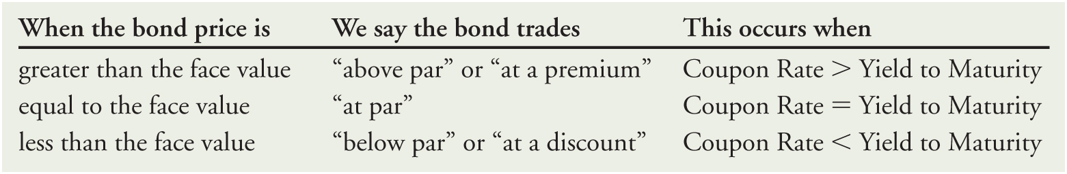
Discounts and Premiums (cont'd)
Table 6.1 Bond Prices Immediately After a Coupon Payment

Slide 28
Time and Bond Prices
Holding all other things constant, a bond’s yield to maturity will not change over time.
Holding all other things constant, the price of discount or premium bond will move toward par value over time.
If a bond’s yield to maturity has not changed, then the IRR of an investment in the bond equals its yield to maturity even if you sell the bond early.

Slide 29
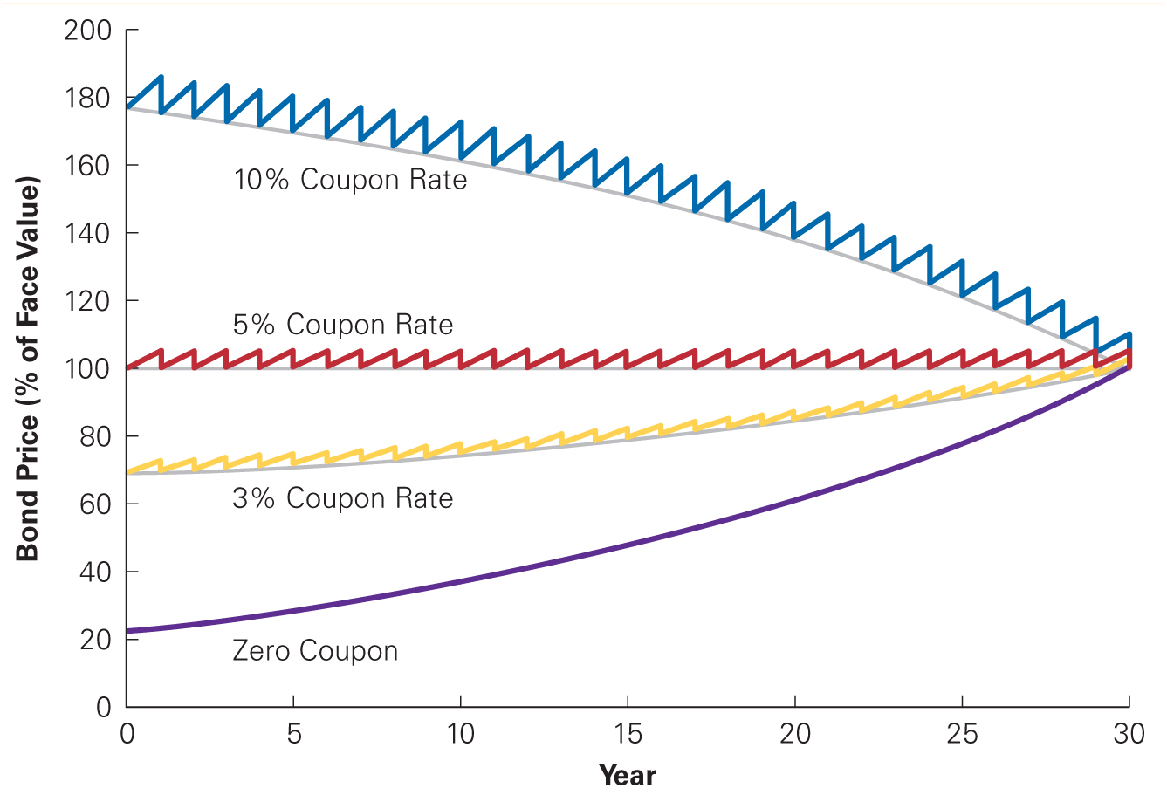
Figure 6.1 The Effect of Time on Bond Prices

Slide 30
Interest Rate Changes and Bond Prices
There is an inverse relationship between interest rates and bond prices.
As interest rates and bond yields rise, bond prices fall.
As interest rates and bond yields fall, bond prices rise.

Slide 31
Interest Rate Changes and Bond Prices (cont'd)
The sensitivity of a bond’s price to changes in interest rates is measured by the bond’s duration.
Bonds with high durations are highly sensitive to interest rate changes.
Bonds with low durations are less sensitive to interest rate changes.

Slide 32
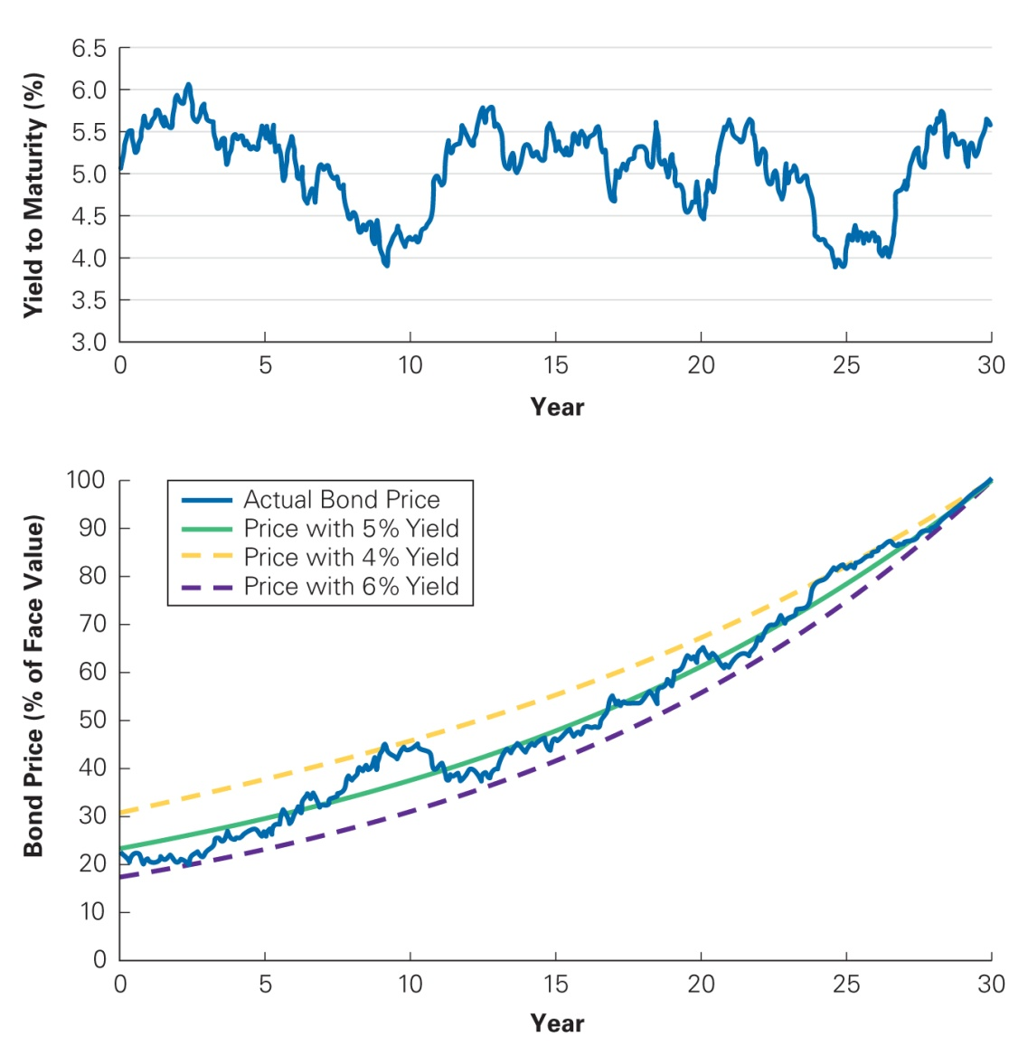
Figure 6.2 Yield to Maturity and Bond Price Fluctuations Over Time

Slide 33
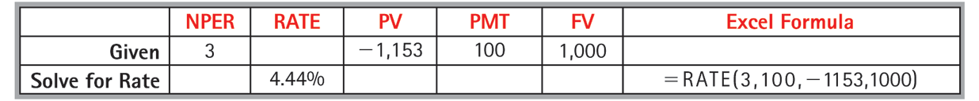
Coupon Bond Yields
Given the yields for zero-coupon bonds, we can price a coupon bond.

Slide 34
Financial Calculator Solution

Slide 35
6.4 Corporate Bonds
Corporate Bonds
Issued by corporations
Credit Risk
Risk of default

Slide 36
Corporate Bond Yields
Investors pay less for bonds with credit risk than they would for an otherwise identical default-free bond.
The yield of bonds with credit risk will be higher than that of otherwise identical default-free bonds.

Slide 37
Corporate Bond Yields (cont'd)
No Default
Consider a 1-year, zero coupon Treasury Bill with a YTM of 4%.
What is the price?

Slide 38
Corporate Bond Yields (cont'd)
Certain Default
Suppose now bond issuer will pay 90% of the obligation.
What is the price?

Slide 39
Corporate Bond Yields (cont'd)
Certain Default
When computing the yield to maturity for a bond with certain default, the promised rather than the actual cash flows are used.

Slide 40
Corporate Bond Yields (cont'd)
Certain Default
The yield to maturity of a certain default bond is not equal to the expected return of investing in the bond. The yield to maturity will always be higher than the expected return of investing in the bond.

Slide 41
Corporate Bond Yields (cont'd)
Risk of Default
Consider a one-year, $1000, zero-coupon bond issued. Assume that the bond payoffs are uncertain.
There is a 50% chance that the bond will repay its face value in full and a 50% chance that the bond will default and you will receive $900. Thus, you would expect to receive $950.
Because of the uncertainty, the discount rate is 5.1%.

Slide 42
Corporate Bond Yields (cont'd)
Risk of Default
The price of the bond will be
The yield to maturity will be

Slide 43
Corporate Bond Yields (cont'd)
Risk of Default
A bond’s expected return will be less than the yield to maturity if there is a risk of default.
A higher yield to maturity does not necessarily imply that a bond’s expected return is higher.

Slide 44
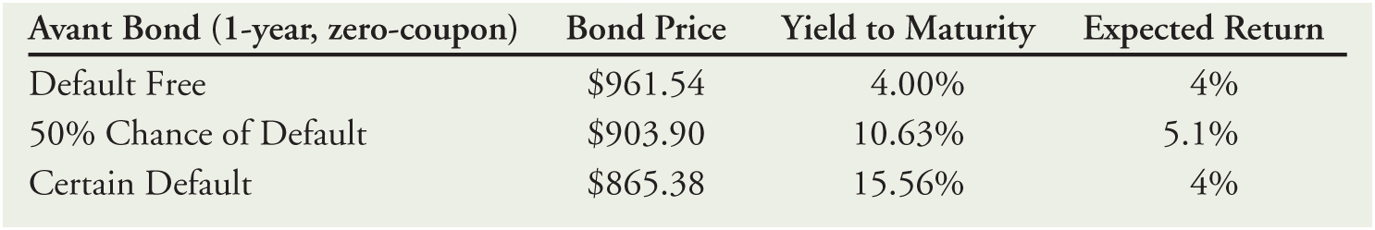
Corporate Bond Yields (cont'd)
Table 6.3 Price, Expected Return, and Yield to Maturity of a One-Year, Zero-Coupon Avant Bond with Different Likelihoods of Default

Slide 45
Bond Ratings
Investment Grade Bonds
Speculative Bonds
Also known as Junk Bonds or High-Yield Bonds

Slide 46
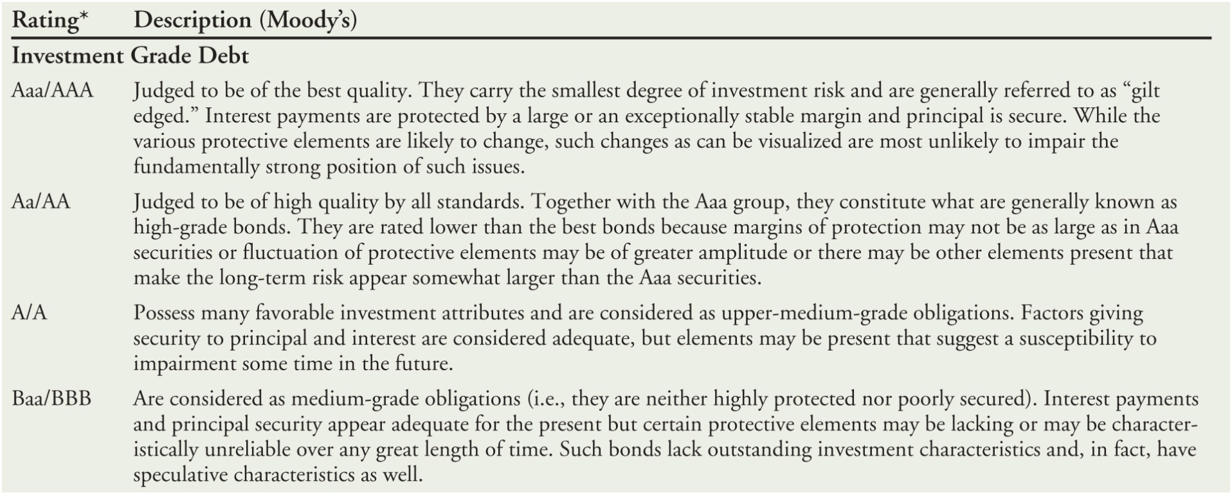
Table 6.4 Bond Ratings

Slide 47
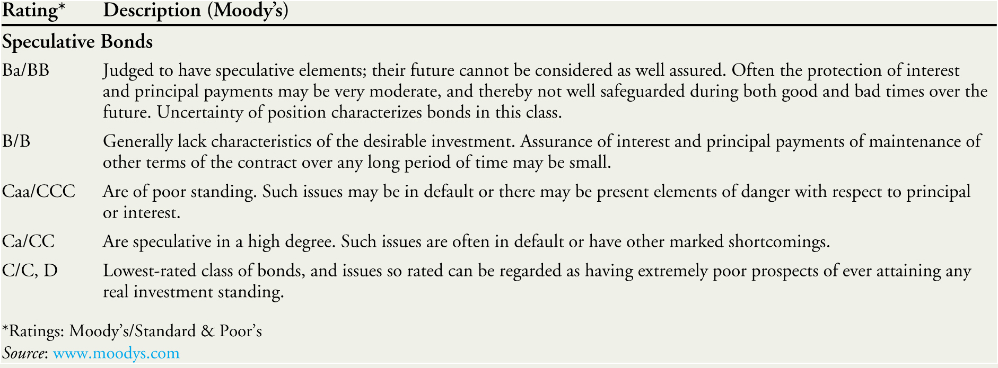
Table 6.4 Bond Ratings (cont’d)
Notes:
47

Slide 48
Corporate Yield Curves
Default Spread
Also known as Credit Spread
The difference between the yield on corporate bonds and Treasury yields

Slide 49
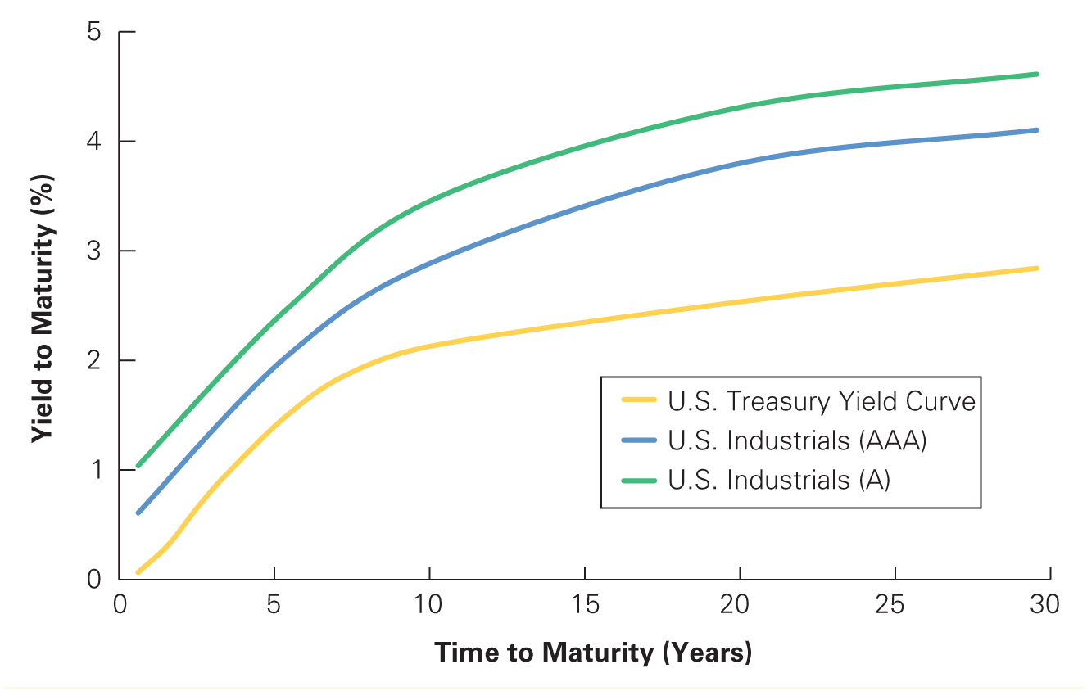
Figure 6.3 Corporate Yield Curves for Various Ratings, August 2015
Source: Yahoo! Finance

Slide 50
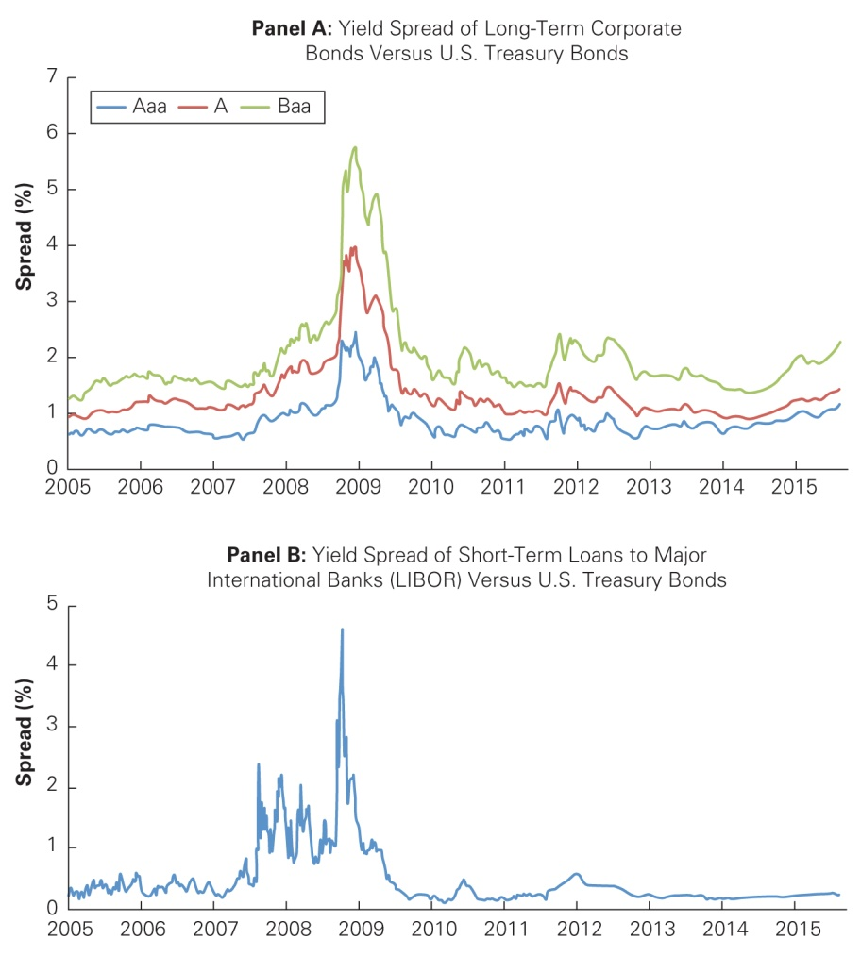
Figure 6.4 Yield Spreads and the Financial Crisis
Source: Bloomberg.com

Slide 51
6.5 Sovereign Bonds
Bonds issued by national governments
U.S. Treasury securities are generally considered to be default free.
All sovereign bonds are not default free,
e.g. Greece defaulted on its outstanding debt in 2012.
Importance of inflation expectations
Potential to “inflate away” the debt
European sovereign debt, the EMU, and the ECB

Slide 52
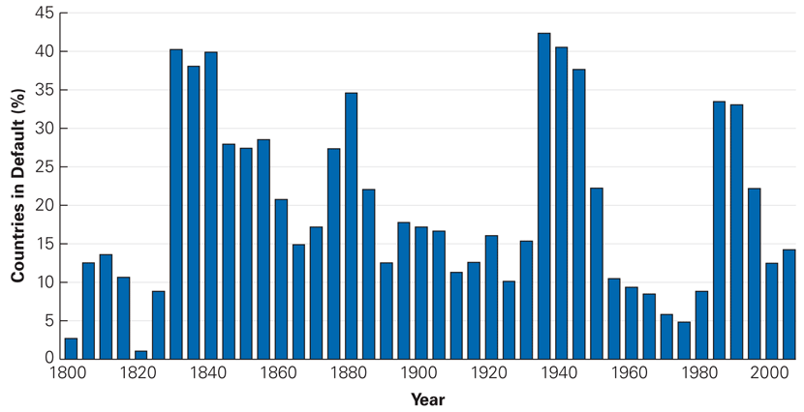
Figure 6.5 Percent of Debtor Countries in Default or Restructuring Debt, 1800–2006
Source: Data from This Time Is Different, Carmen Reinhart and Kenneth Rogoff, Princeton University Press, 2009.

Slide 53
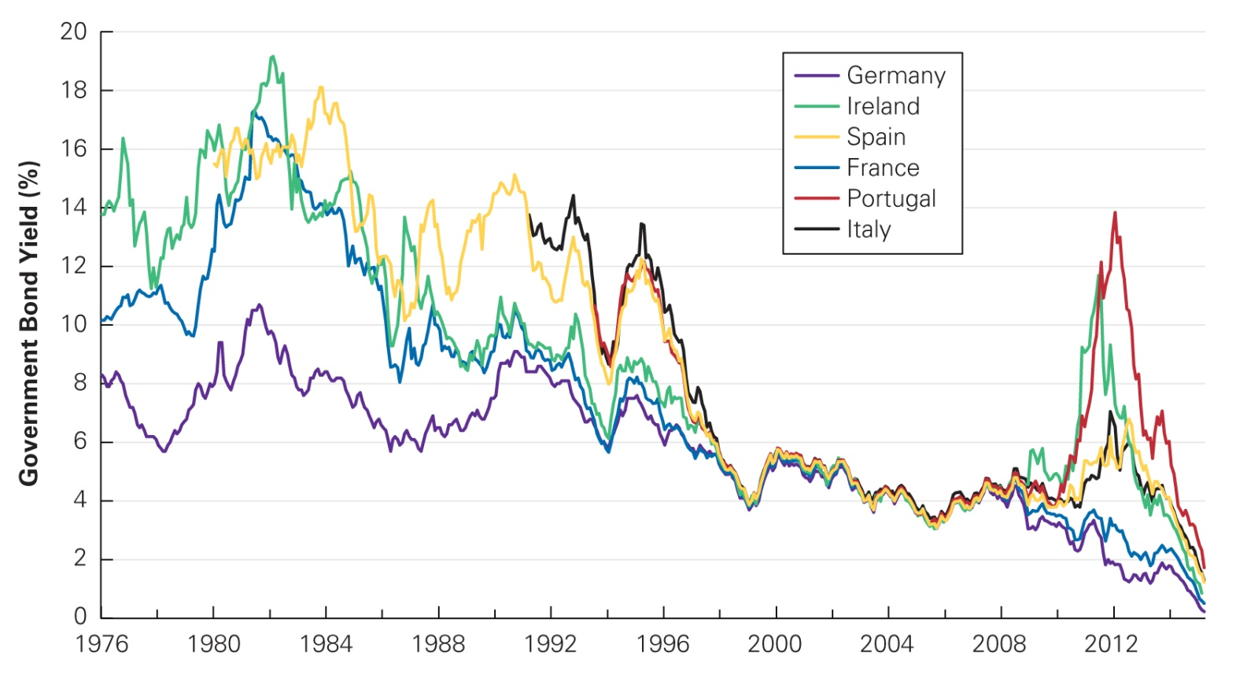
Figure 6.6 European Government Bond Yields, 1976–2015
Source: Federal Reserve Economic Data, research.stlouisfed.org/fred2.

